Slide 1

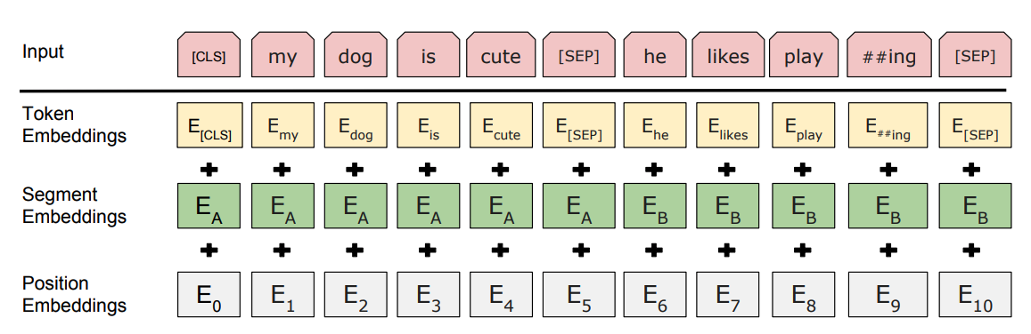
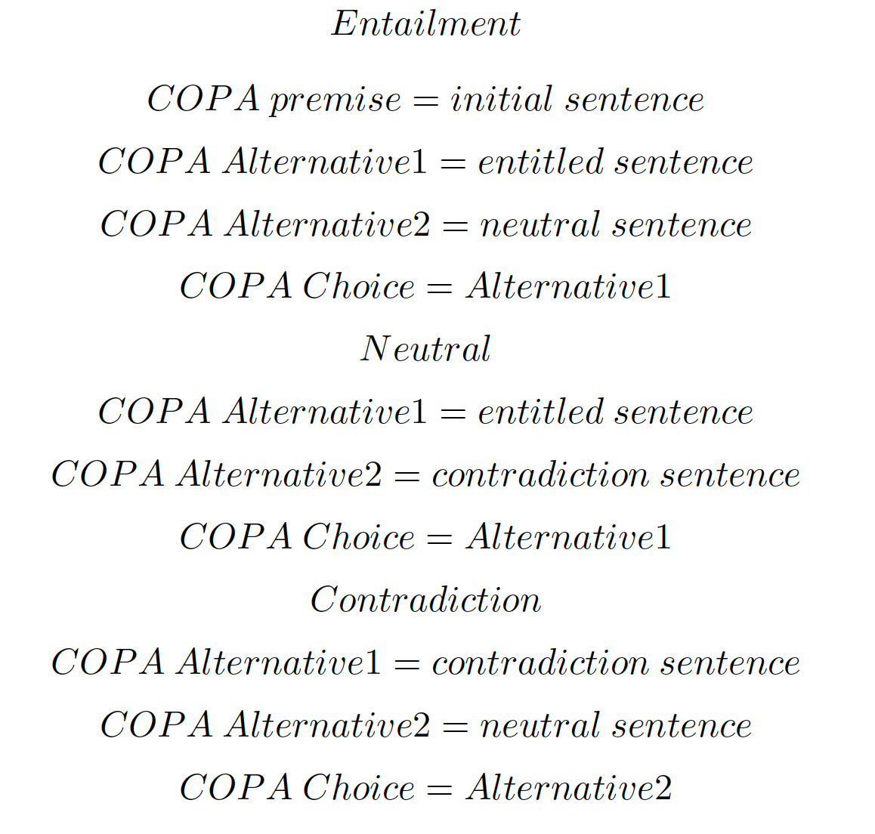
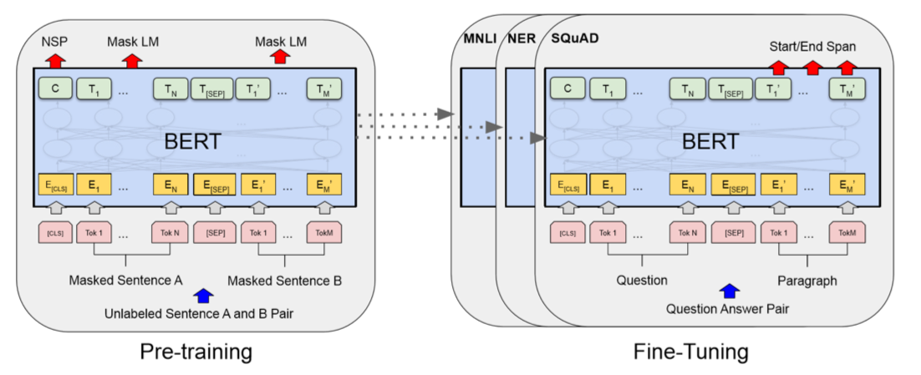
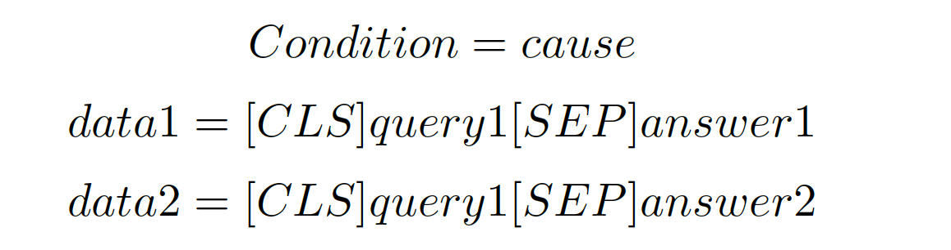
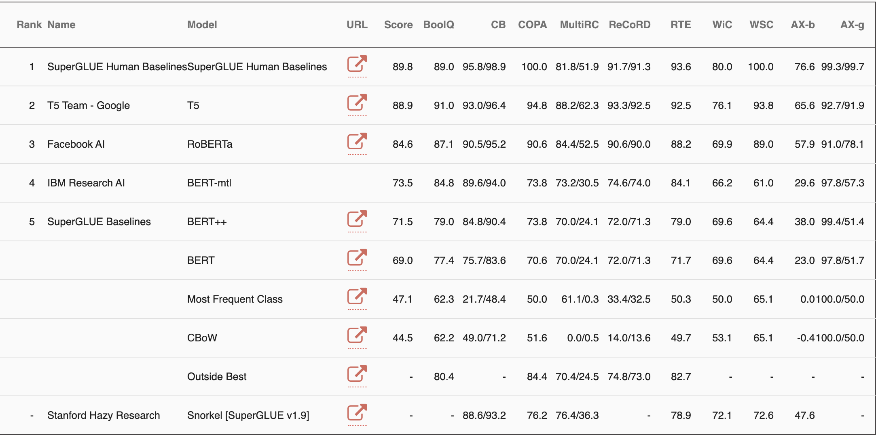
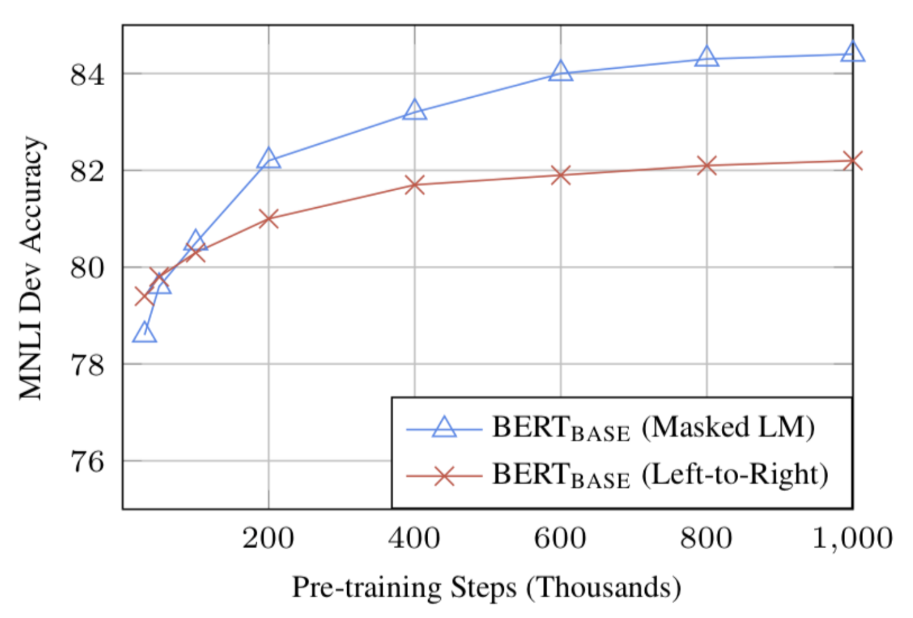
Template Provided By Genigraphics – 800.790.4001
Replace This Text With Your Title
John Smith, MD¹; Jane Doe, PhD²; Frederick Smith, MD, PhD^{1,2}
¹University of Affiliation, ²Medical Center of Affiliation
ABSTRACT
COPA
RESULTS
DISCUSSION
Recent latent semantics analysis are based on calculating the word vector distance between target and goal sentences or proposing generalized semantic hypothesis according to the original text. In this project, we explore the higher level mission on challenging one of the COPA task which is analysing common sense from ordinary scenario description text. We successfully boost our BERT model performance with test accuracy of 78\% among IBM research AI, BERT-mtl model with accuracy of 73.8\% on the SuperGlue leaderboard 2.0. During the enhancement of model, we conjecture that the key factors in model performance is that (1) The word embedding format. (2) The scale of our fine tuning data. (3) The configuration of BERT model Introduction. We demonstrated the potential of BERT model. Experiments shows new state-of-the-art of BERT model results on COPA without any bells and whistles.
Choice of Plausible Alternatives (COPA)
The Choice Of Plausible Alternatives (COPA) evaluation provides researchers with a tool for assessing progress in open-domain commonsense causal reasoning. COPA consists of 1000 questions, split equally into development and test sets of 500 questions each. Each question is composed of a premise and two alternatives, where the task is to select the alternative that more plausibly has a causal relation with the premise. The correct alternative is randomized so that the expected performance of randomly guessing is 50%.
COPA example:
Premise: The man broke his toe. What was the CAUSE of this? Alternative 1: He got a hole in his sock. Alternative 2: He dropped a hammer on his foot.
Premise: I tipped the bottle. What happened as a RESULT? Alternative 1: The liquid in the bottle froze. Alternative 2: The liquid in the bottle poured out.
Premise: I knocked on my neighbor's door. What happened as a RESULT? Alternative 1: My neighbor invited me in. Alternative 2: My neighbor left his house.
In the BERT training process, the model receives pairs of sentences as input and learns to predict if the second sentence in the pair is the subsequent sentence in the original document. During training, 50% of the inputs are a pair in which the second sentence is the subsequent sentence in the original document, while in the other 50% a random sentence from the corpus is chosen as the second sentence. The assumption is that the random sentence will be disconnected from the first sentence. To predict if the second sentence is indeed connected to the first, the following steps are performed:
The entire input sequence goes through the Transformer model.
The output of the [CLS] token is transformed into a 2×1 shaped vector, using a simple classification layer (learned matrices of weights and biases).
Calculating the probability of IsNextSequence with softmax.
Click here to insert your Discussion text. Type it in or copy and paste from your Word document or other source.
This text box will automatically re-size to your text. To turn off that feature, right click inside this box and go to Format Shape, Text Box, Autofit, and select the “Do Not Autofit” radio button.
To change the background color of any text box, click once on the box so it is outlined with a dashed border. Then select Shape Fill from the Drawing Tools, Format tab on the ribbon bar above. It’s the one with the ‘paint can’ icon.
 | Heading | Heading | Heading
Item | 800 | 790 | 4001
Item | 356 | 856 | 290
Item | 228 | 134 | 238
Item | 954 | 875 | 976
Item | 324 | 325 | 301
Item | 199 | 137 | 186
EXPERIMENT
As stated before, the COPA task provides a training dataset of 400 examples and evaluation dataset of 100 examples
We are generating new COPA training data by taking the MultiNLI training data
We will pre-process our data similar to how we would for the Siamese LSTM model, except this time we will add [CLS] to the start of the data field, and use [SEP] to separate the premise and the possible cause & effects
BERT will create an contextual aware embedding vector for each word part in the two sentences. It will also create a embedding value for the tokens [CLS] and [SEP] which is based on sentence level embedding
CONCLUSIONS
Click here to insert your Conclusions text. Type it in or copy and paste from your Word document or other source.
To change the font style of this text box: Click on the border once to highlight the entire text box, then select a different font or font size that suits you. This text is Calibri 22pt and is easily read up to 4 feet away on a 24x36 poster.
Zoom out to 100% to preview what this will look like on your printed poster.
Figure 1. MultiNLI to COPA
CONTACT
Figure 2. BERT words Token
REFERENCES
<your name>
<your organization>
Email:
Phone:
Website:
Click here to insert your References. Type it in or copy and paste from your Word document or other source.
Click on the border once to highlight and select a different font or font size that suits you. This text is in Calibri 20pt and is easily readable up to 3 feet away.
Figure 3. BERT model

